Slide 1




PREVENTIVE MONITORING of the project:
619451-EPP-1-2020-1-NL-EPPKA2-CBHE-JP
INTERNATIONAL STUDENTS
ADAPTATION AND INTEGRATION /
INTERADIS
SUMY NATIONAL AGRARIAN UNIVERSITY
Kharkiv, V. N. Karazin Kharkiv National University
01.10.2021

Slide 2

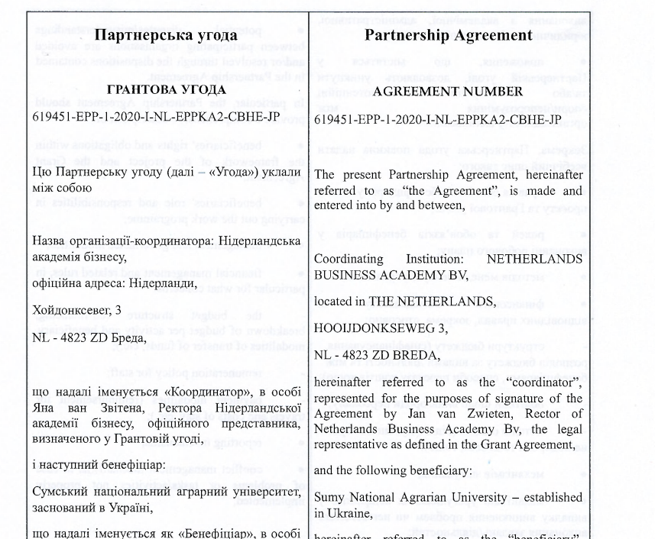
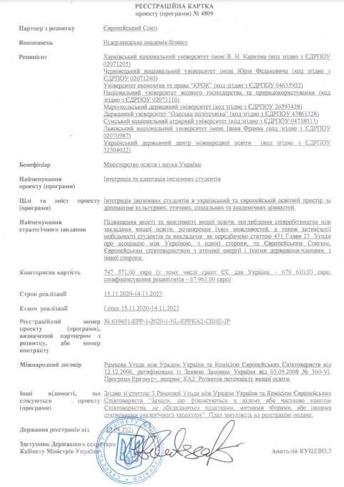
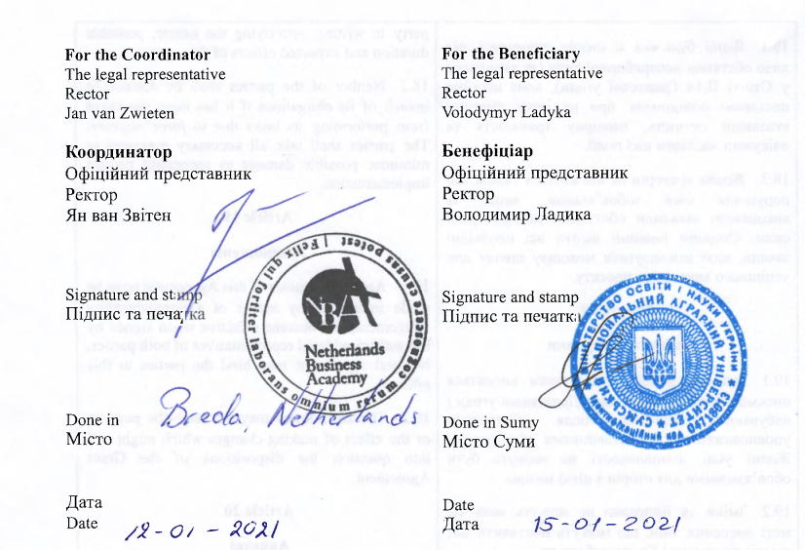
PROJECT’S LEGAL
FOOTING
State registration of the project from 20.08.2021
(exemption from VAT)
Partnership agreement
January 2021

Slide 3

SNAU’s role in the project
WP# | WP type | WP title | Lead Organisation | SNAU’s role
WP 1 | PREPARATION | Learning of EU experience | OTHAW | Participant
WP 2 | DEVELOPMENT | Development of internationalization capacity | KKNU | Participant
WP 3 | DEVELOPMENT | Implementation of the Roadmap | CHNU | Participant
WP 4 | DEVELOPMENT | Training and mobility activities | MRU | Participant
WP 5 | QUALITY PLAN | Quality management | HuG | Participant
WP 6 | DISSEMINATION & EXPLOITATION | Dissemination and exploitation | KROK | Participant
WP 7 | MANAGEMENT | Project Management | NLBA | Participant

Slide 4
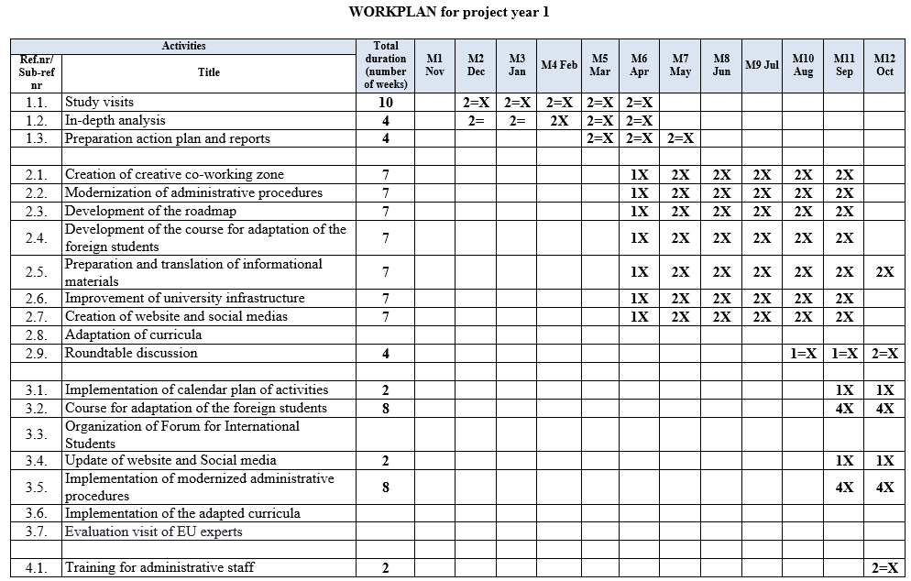
WORKPLAN for project year 1

Slide 5
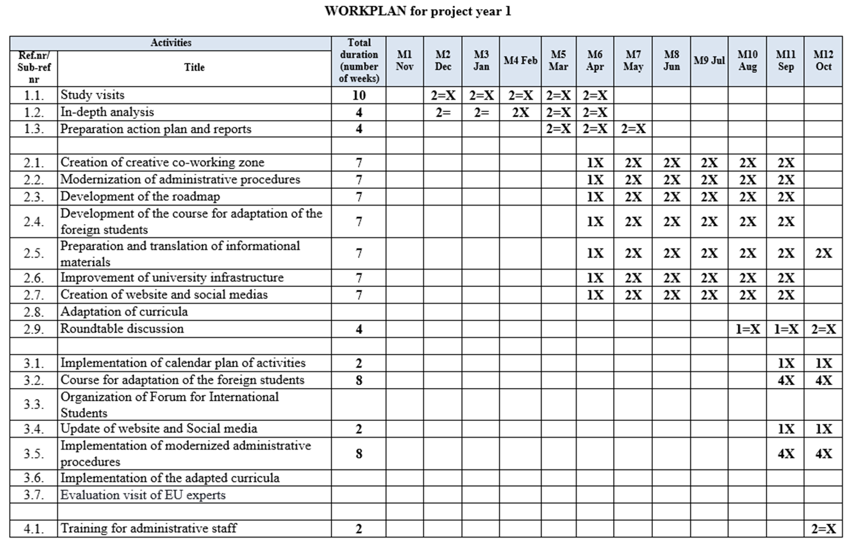
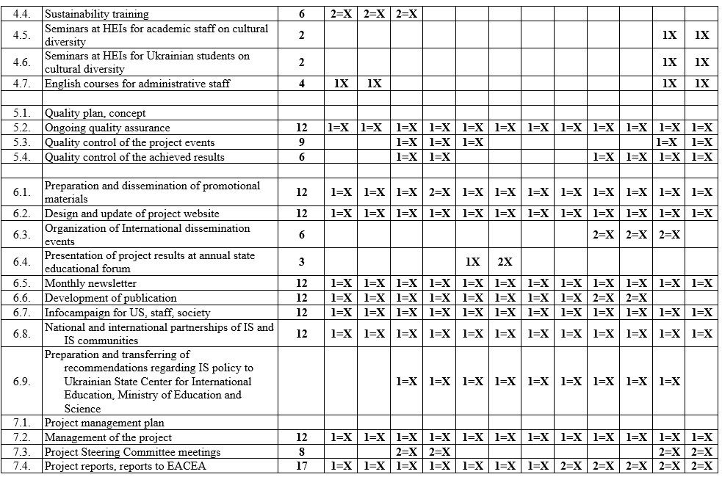
WORKPLAN for project year 1

Slide 6
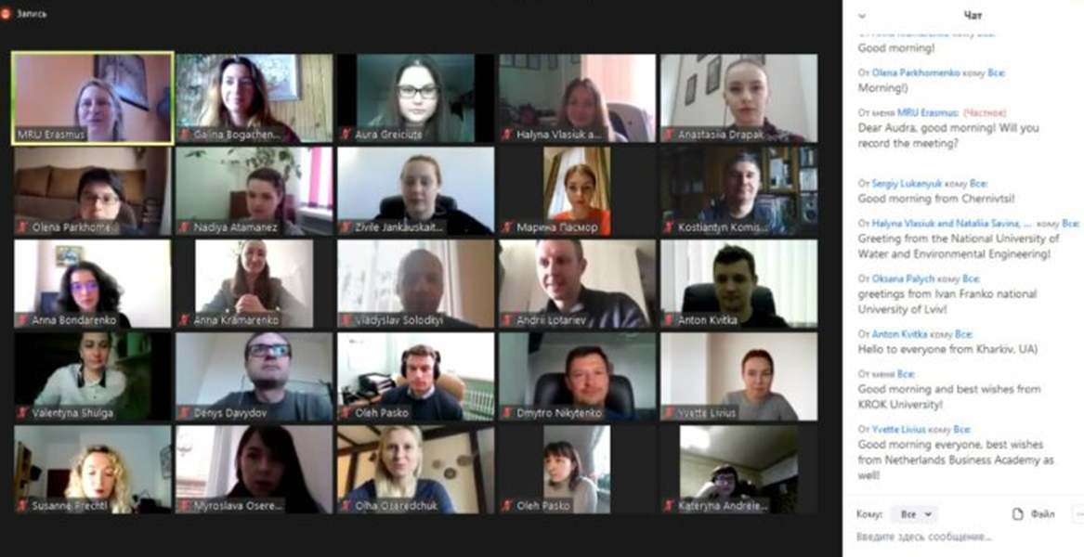
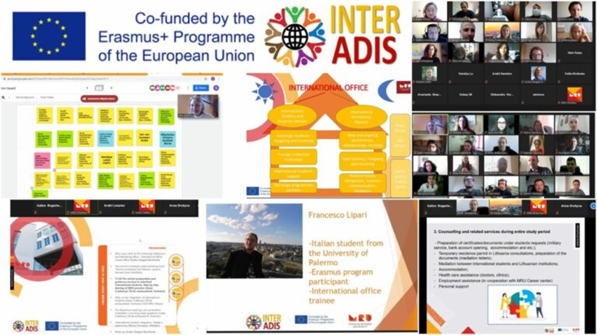
ONLINE STUDY VISITS
 | Date
Mykolas Romeris University, Lithuania https://bit.ly/3tLzA8y | 14.04.2021
Ostbayerische Technische Hochschule Amberg-Weiden, Germany https://bit.ly/3tJ9zaa | 16.04.2021
Netherlands Business Academy, the Netherlands https://bit.ly/3hGvSbB | 20.04.2021
Foggia University, Italy https://bit.ly/3zapLSU | 28.04.2021
https://bit.ly/3lublbm

Slide 7

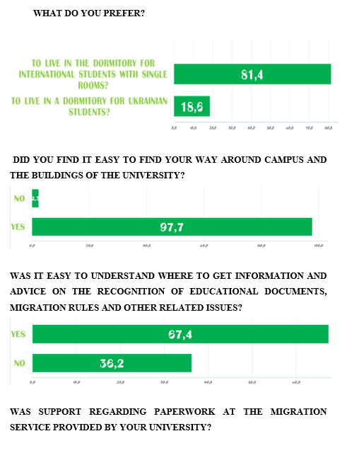
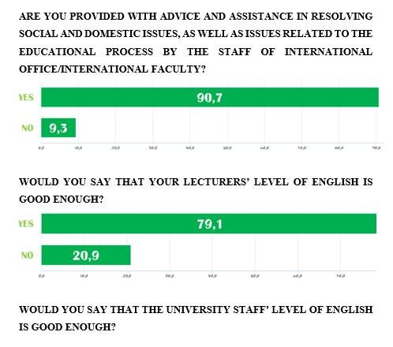
IN-DEPTH ANALYSIS
Results soon on university’s project website
https://bit.ly/2XEOty1

Slide 8
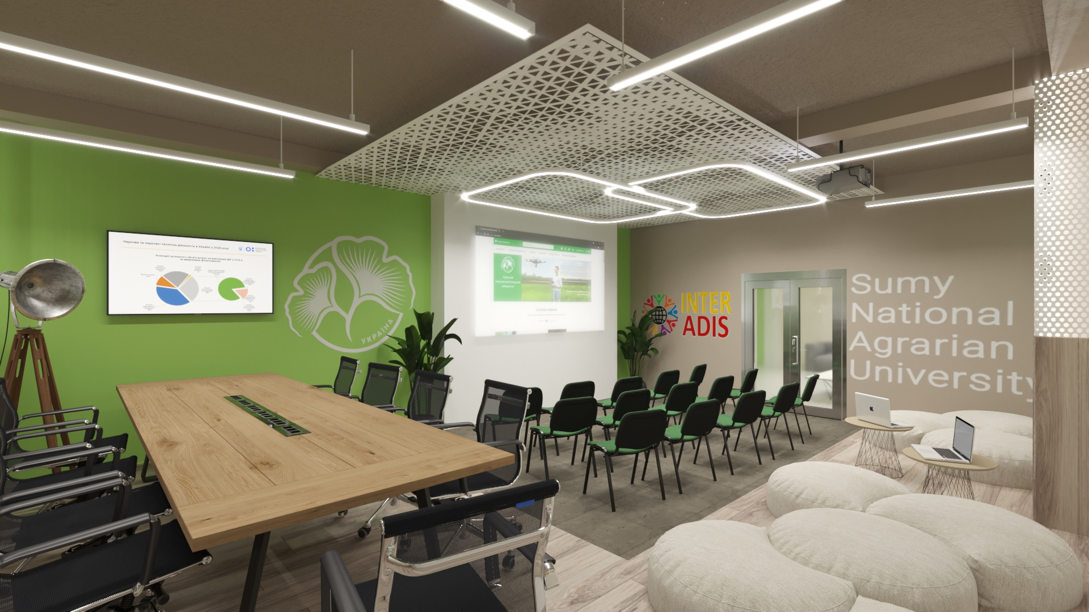
CREATION OF CREATIVE CO-WORKING ZONE
Preparation
Implementation
Up and running
Phase
Status
Phase
Status
Depends on Purchase of equipment
Late November 2021 – Early December 2021
3-D visualization
Done
Consultative idea development
Done
https://bit.ly/3hDq3Mc
https://bit.ly/39h5P64
Place
renovation
Under way
Submission of documents for state registration of the project (exemption from VAT)
State registration of the project (exemption from VAT)
Done
20/08/2021
Done
Purchase of equipment
Road is clear

Slide 9
Status
MODERNIZATION OF ADMINISTRATIVE PROCEDURES
Due to the postponement of study visits to European partner universities, where we must learn best practices, this item is postponed until «after study visits».
This corresponds to the spirit and letter of the project, where work package 1 (study visits) precedes work package 2 (modernization of administrative procedures).
administrative procedures: applicant selection, enrollment, housing, informational and administrative support during training.
Pending:
Consideration, gathering of info
DEVELOPMENT OF THE ROADMAP
The Roadmap on IS integration should include all aspects regarding IS and indicate the main challenges and solutions of interaction with IS in terms of administrative procedures, training and social life in order to integrate them into social life of society, where they obtain education and learn EU values. It will include the principles of work, list and plan of the cultural, networking activities and calendar plan of yearly activities, description of upgraded administrative procedures.
Pending:
Consideration, gathering of info

Slide 10
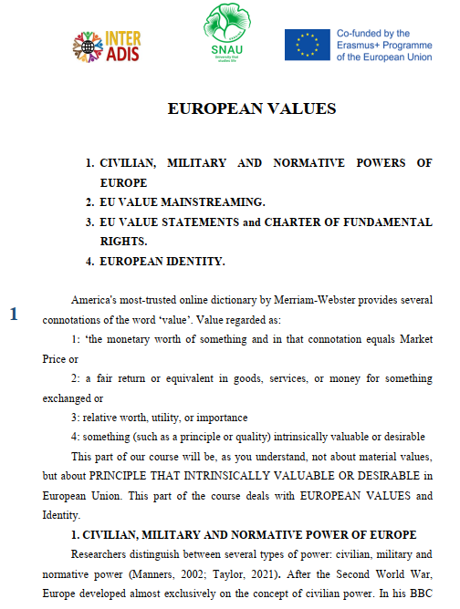
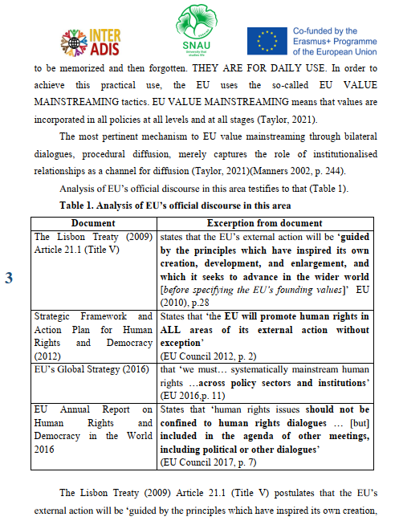
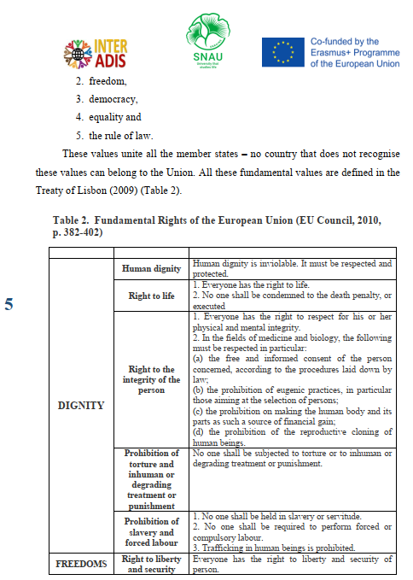
DEVELOPMENT OF THE COURSE FOR ADAPTATION OF THE FOREIGN STUDENTS
Phase
Status
Content development
Done
Video lectures development
Under way
Integration of the course into Moodle platform
October 2021

Slide 11
PREPARATION AND TRANSLATION OF INFORMATIONAL PROMOTIONAL MATERIALS 2.5/6.1
PROMOTIONAL MATERIALS
INFORMATIONAL MATERIALS
The list and content of informational materials
under consideration
Promotion video of SNAU
https://bit.ly/3lpAT9A
SNAU’s leaflets are being developed
SNAU’s InterADIS roll up prepared:
FB page of SNAU
https://www.facebook.com/Interadis.snau
Web page of SNAU
https://bit.ly/2XEOty1

Slide 12
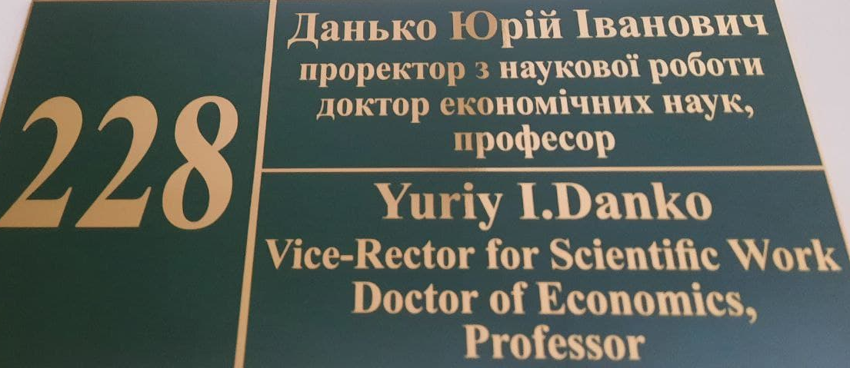
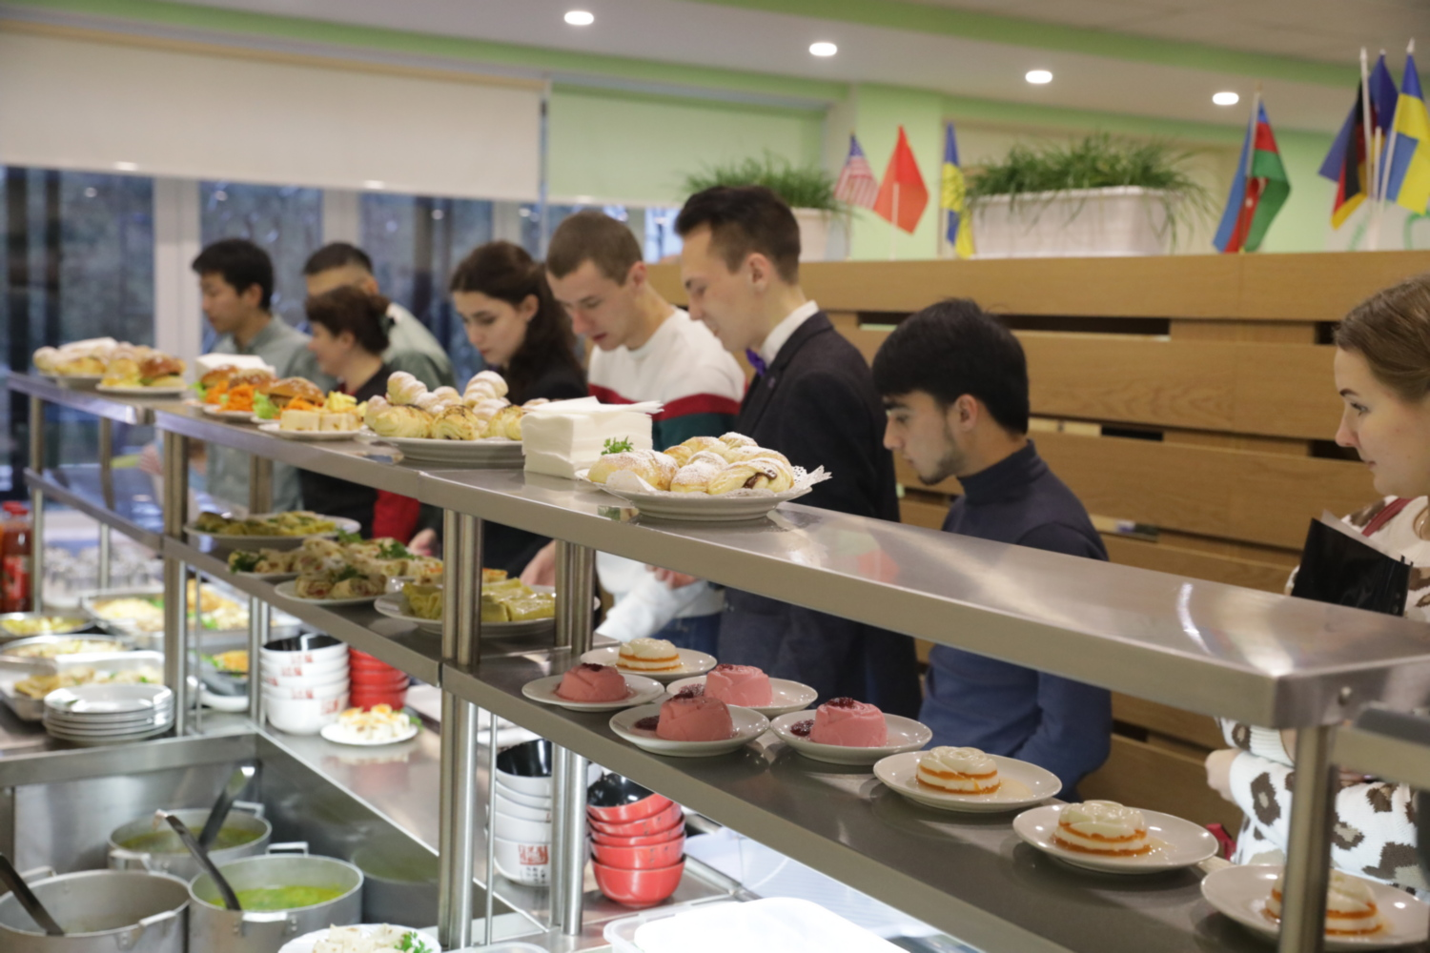
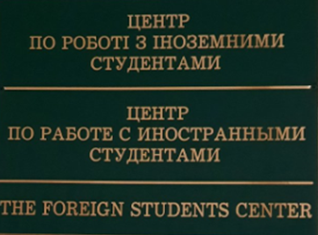
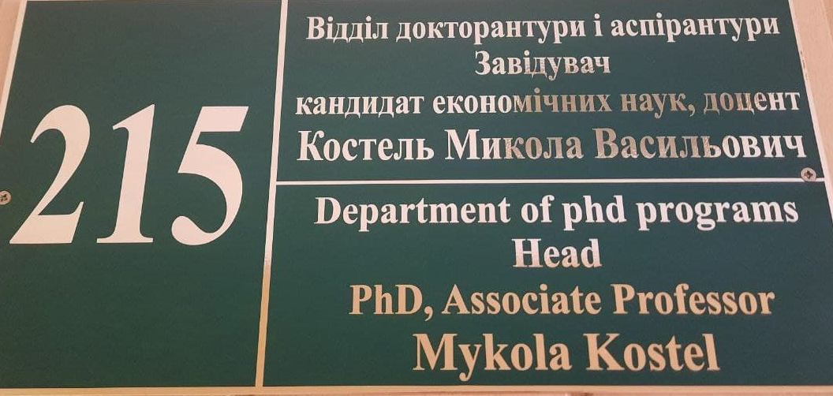

IMPROVEMENT OF UNIVERSITY INFRASTRUCTURE
Needs, deficiencies of university infrastructure regarding appropriateness for IS are going to be reviewed during study visits and training. The SNAU’s list of what has to be done is being developed.
Signs with names and directions of classes and facilities in English, detailed menu in English prepared in the canteen

Slide 13


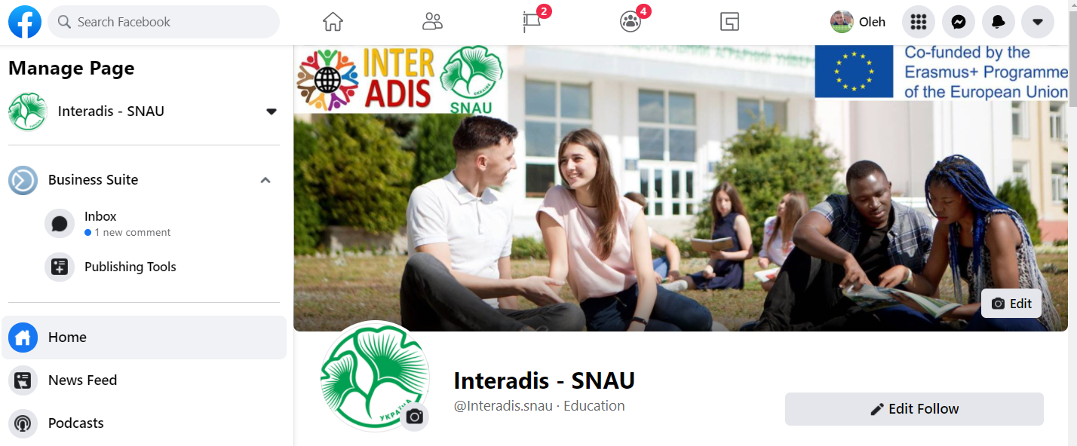
CREATION OF WEBSITE AND SOCIAL MEDIAS
Project’s ones
SNAU’s
Web page
FB page of SNAU
https://interadiscoordinat.wixsite.com/interadis
https://www.facebook.com/Interadis.snau
FB page
https://www.facebook.com/InternationalStudentsAdaptationandntegration
Web page of SNAU
https://bit.ly/2XEOty1

Slide 14

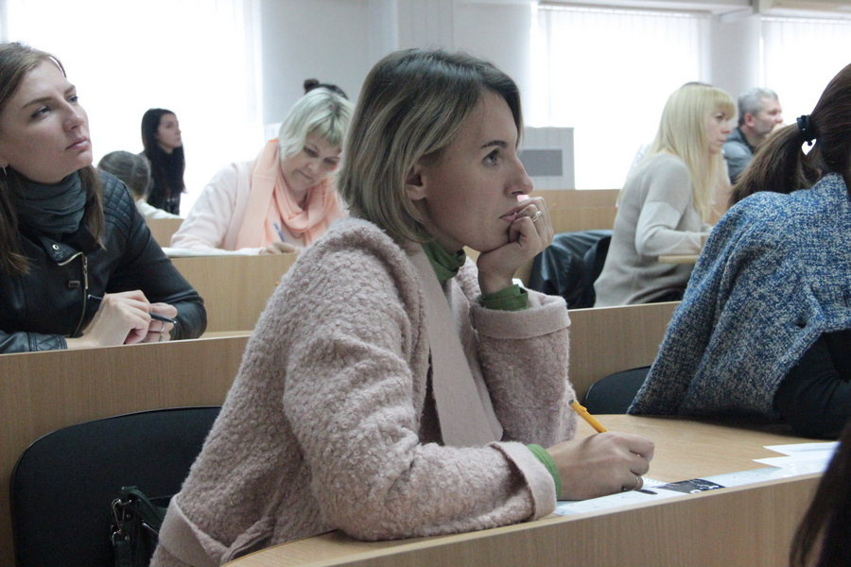
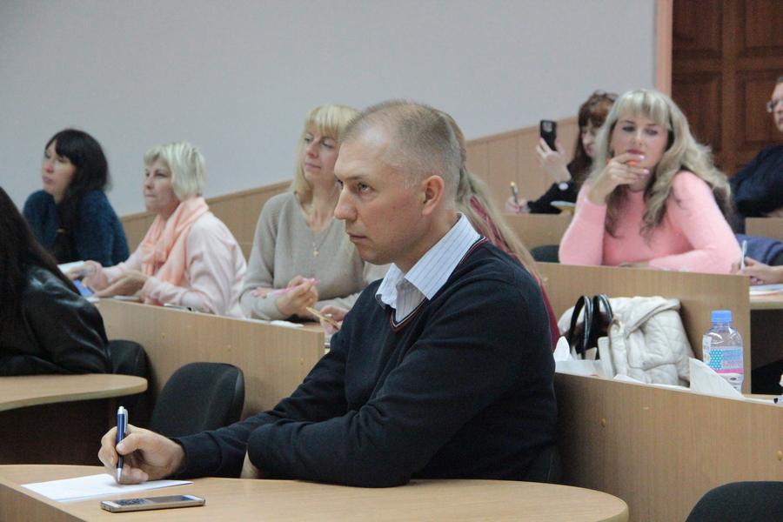
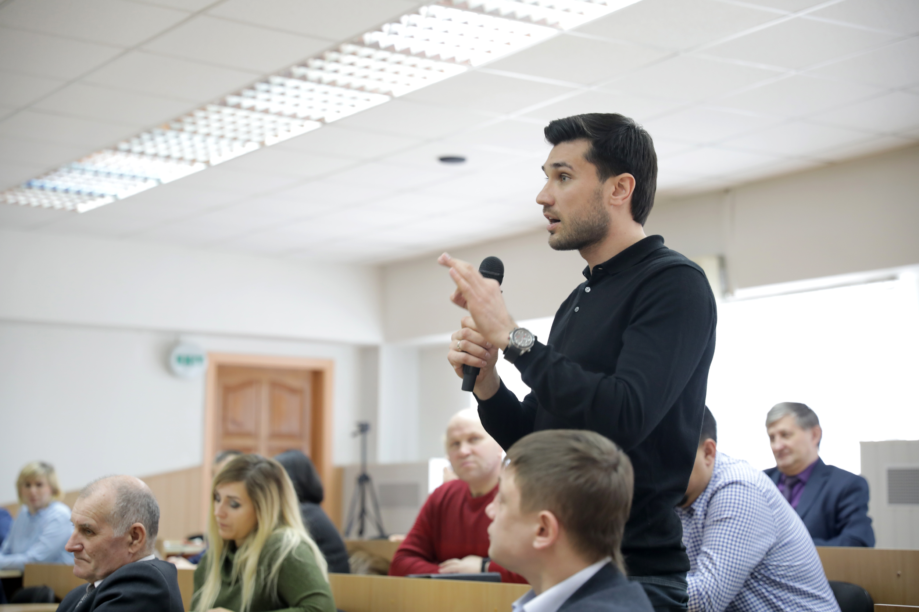
ENGLISH COURSES FOR ADMINISTRATIVE STAFF
The first class of 10-15 administrative staff is expected to start in October 2021.
3 months / 3 lessons per week

Slide 15

QUALITY CONTROL
HuG will support the project management and WP owners in reviewing objectives, priorities, methodology, and planned activities (planning support function), Advising project implementation and help solve issues (advisory function), Providing tools to foster engagement, commitment and accountability (“catalyst function”) and Assessing results/impact/sustainability/visibility (control function)
WP leader
Hultgren Nachhaltigkeitsberatung UG,
Germany

Slide 16
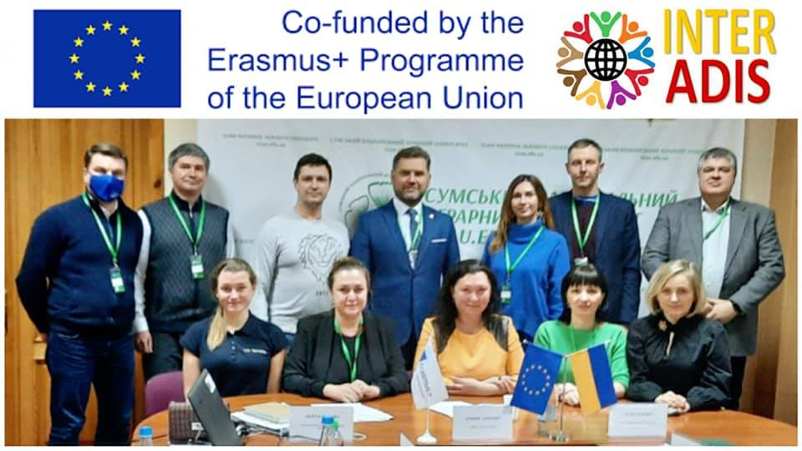

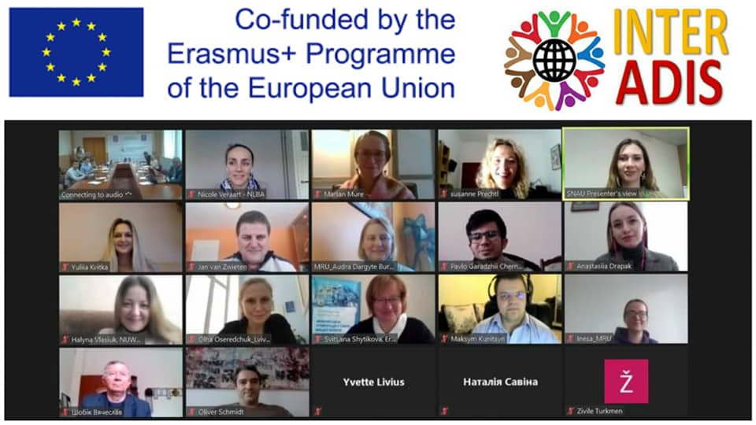
MANAGEMENT OF THE PROJECT
Kick-off meeting held in Sumy
12-13 February 2021
Video: https://bit.ly/3AkOdSM
FB: https://bit.ly/3lsucnm

Slide 17
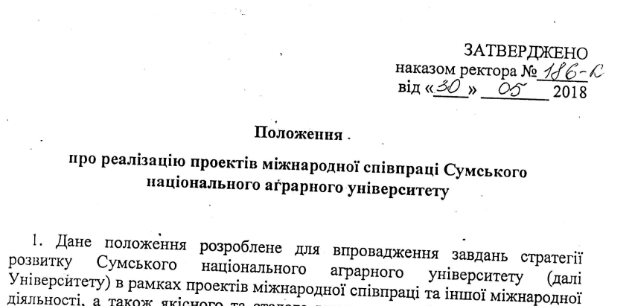
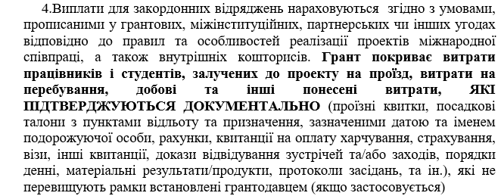
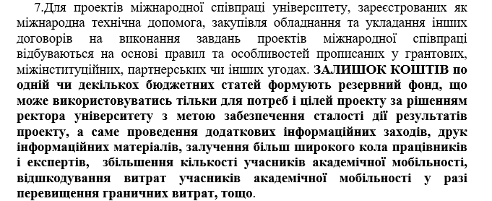

FINANCIAL MANAGEMENT OF THE PROJECT
https://bit.ly/3CnCjYU
Overall budget: 79140 Euro
Staff costs 19490 Euro
Travel costs 15490 Euro
Costs of stay 32260 Euro
Equipment costs 10000 Euro
Subcontracting costs 1900 Euro
Used funds: 2434 Euro
Staff costs 65279,08 UAH
Taxes related to SC 14361,40 UAH

Slide 18
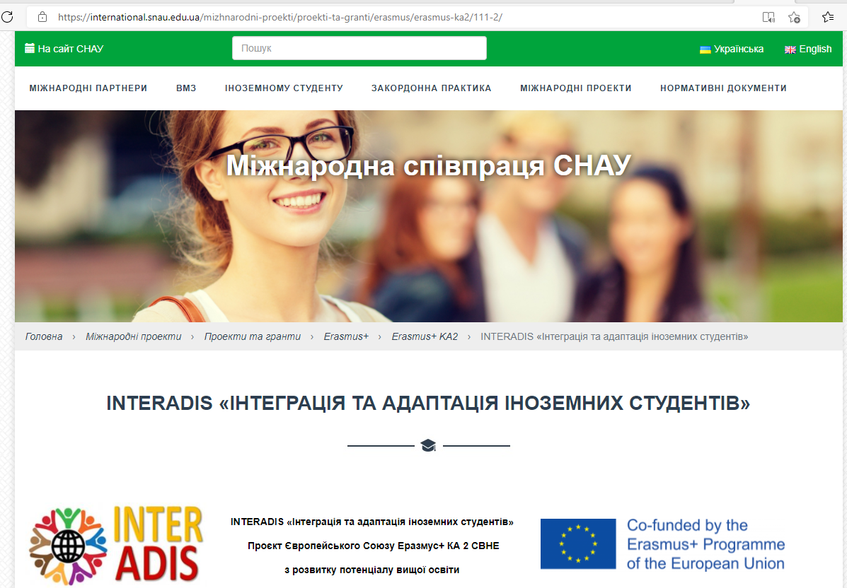
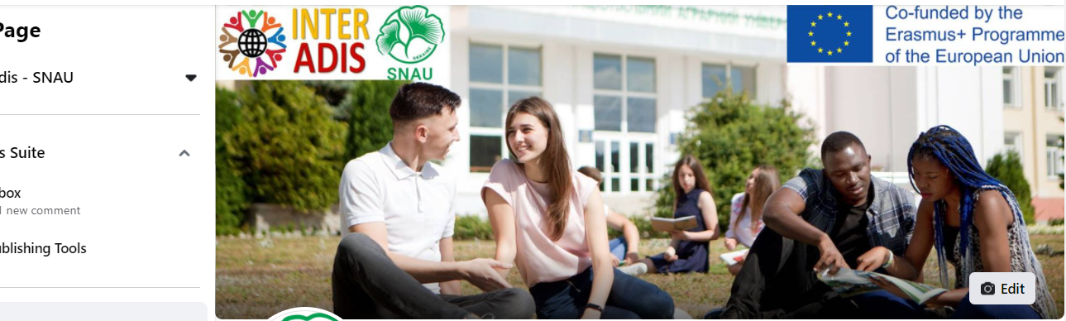
VISUALIZATION REQUIREMENT ERASMUS +
https://www.facebook.com/Interadis.snau
https://bit.ly/2XEOty1

Slide 19
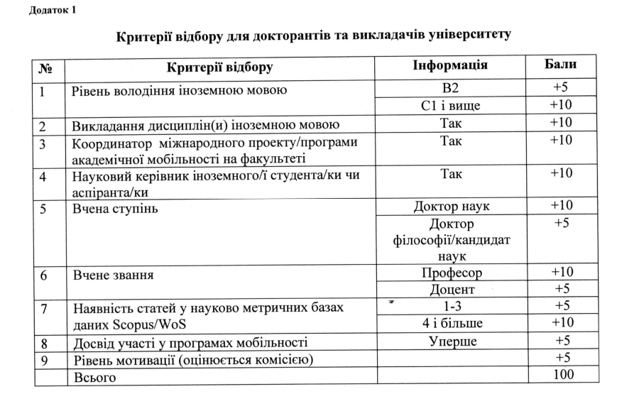
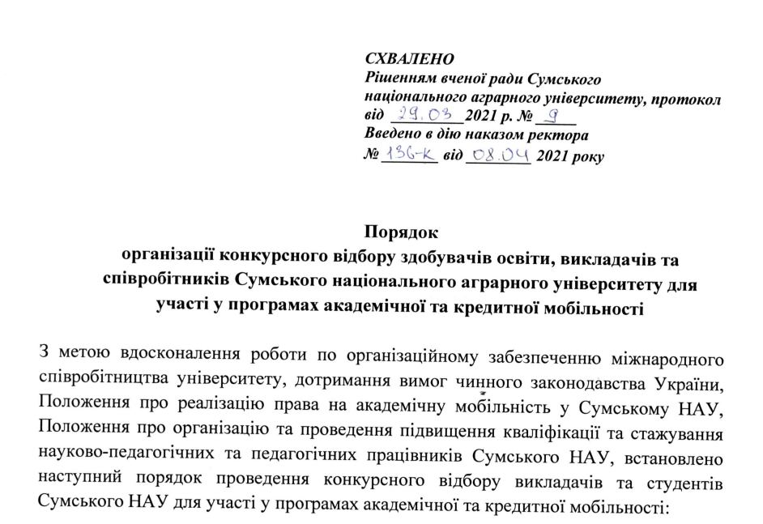
SELECTION POLICY OF CANDIDATES FOR ACADEMIC AND CREDIT MOBILITY
https://bit.ly/3CpLCaU

Slide 20


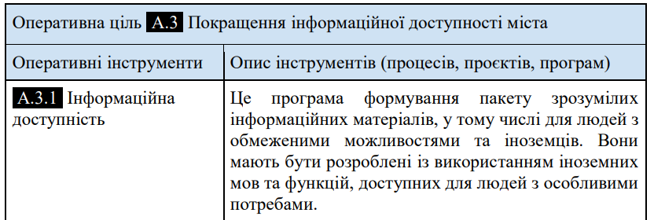
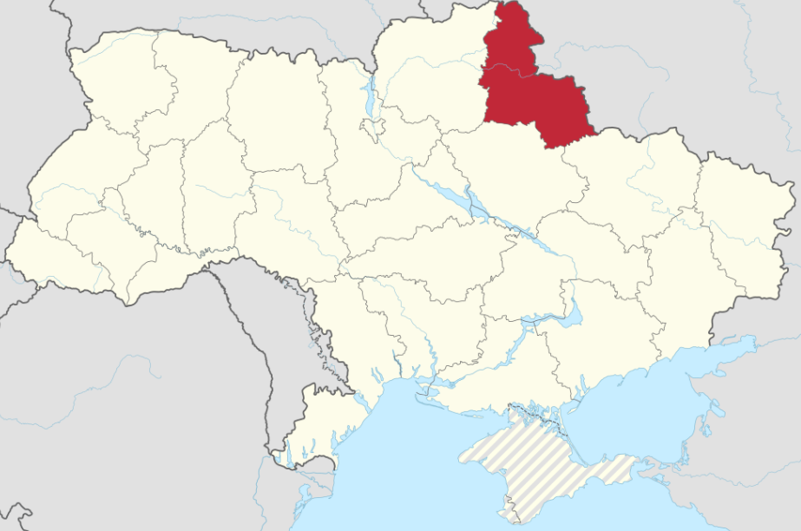
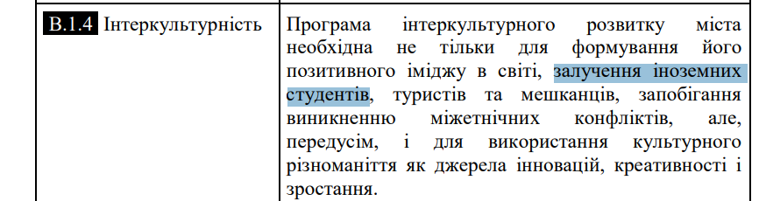
SUSTAINABILITY OF PROJECT RESULTS
In the Sumy region in the 2020-2021 academic year there were 2404 foreign students from around the world (about 60).
Every year the number of incoming students tends to increase. Thus, only from 2017 to 2021 the number of foreign students has doubled.
Sumy Regional State Administration together with universities of the region initiated the creation of the promotional video Education Sumy Region Comfortable Spaсe
Development strategy of the city
of Sumy 2030
https://bit.ly/3kmLl2b

Slide 21
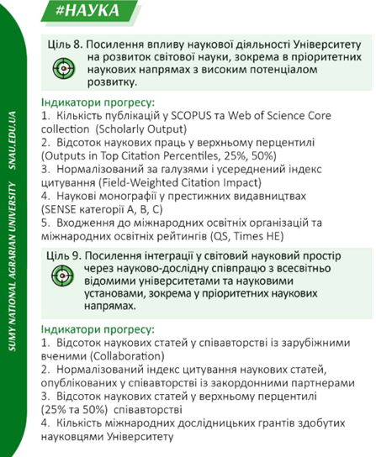

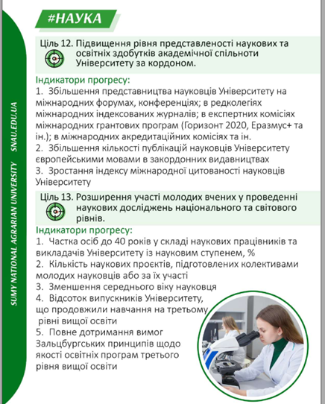

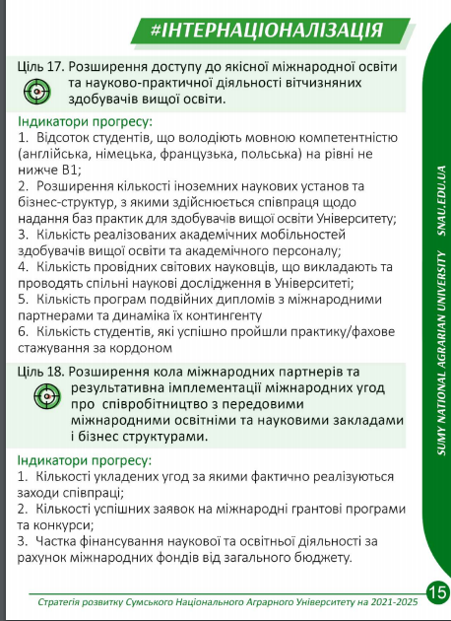
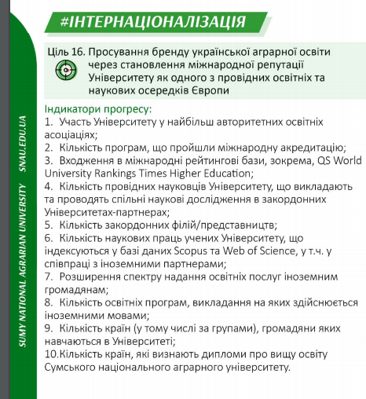


SUSTAINABILITY OF PROJECT RESULTS + EUROPEAN PRINCIPLES
https://bit.ly/3cuNmWP

Slide 22
SUSTAINABILITY OF PROJECT RESULTS
In the Sumy region in the 2020-2021 academic year there were 2404 foreign students from around the world (about 60).
Every year the number of incoming students tends to increase. Thus, only from 2017 to 2021 the number of foreign students has doubled.
Sumy Regional State Administration together with universities of the region initiated the creation of the promotional video Education Sumy Region Comfortable Spaсe
Development strategy of the city
of Sumy 2030
https://bit.ly/3kmLl2b

Slide 23












SYNERGY OF THE PROJECT WITH OTHER PROJECTS
https://bit.ly/3tRe16M

Slide 24
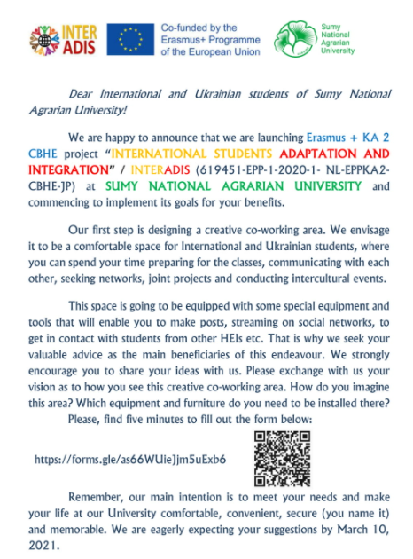
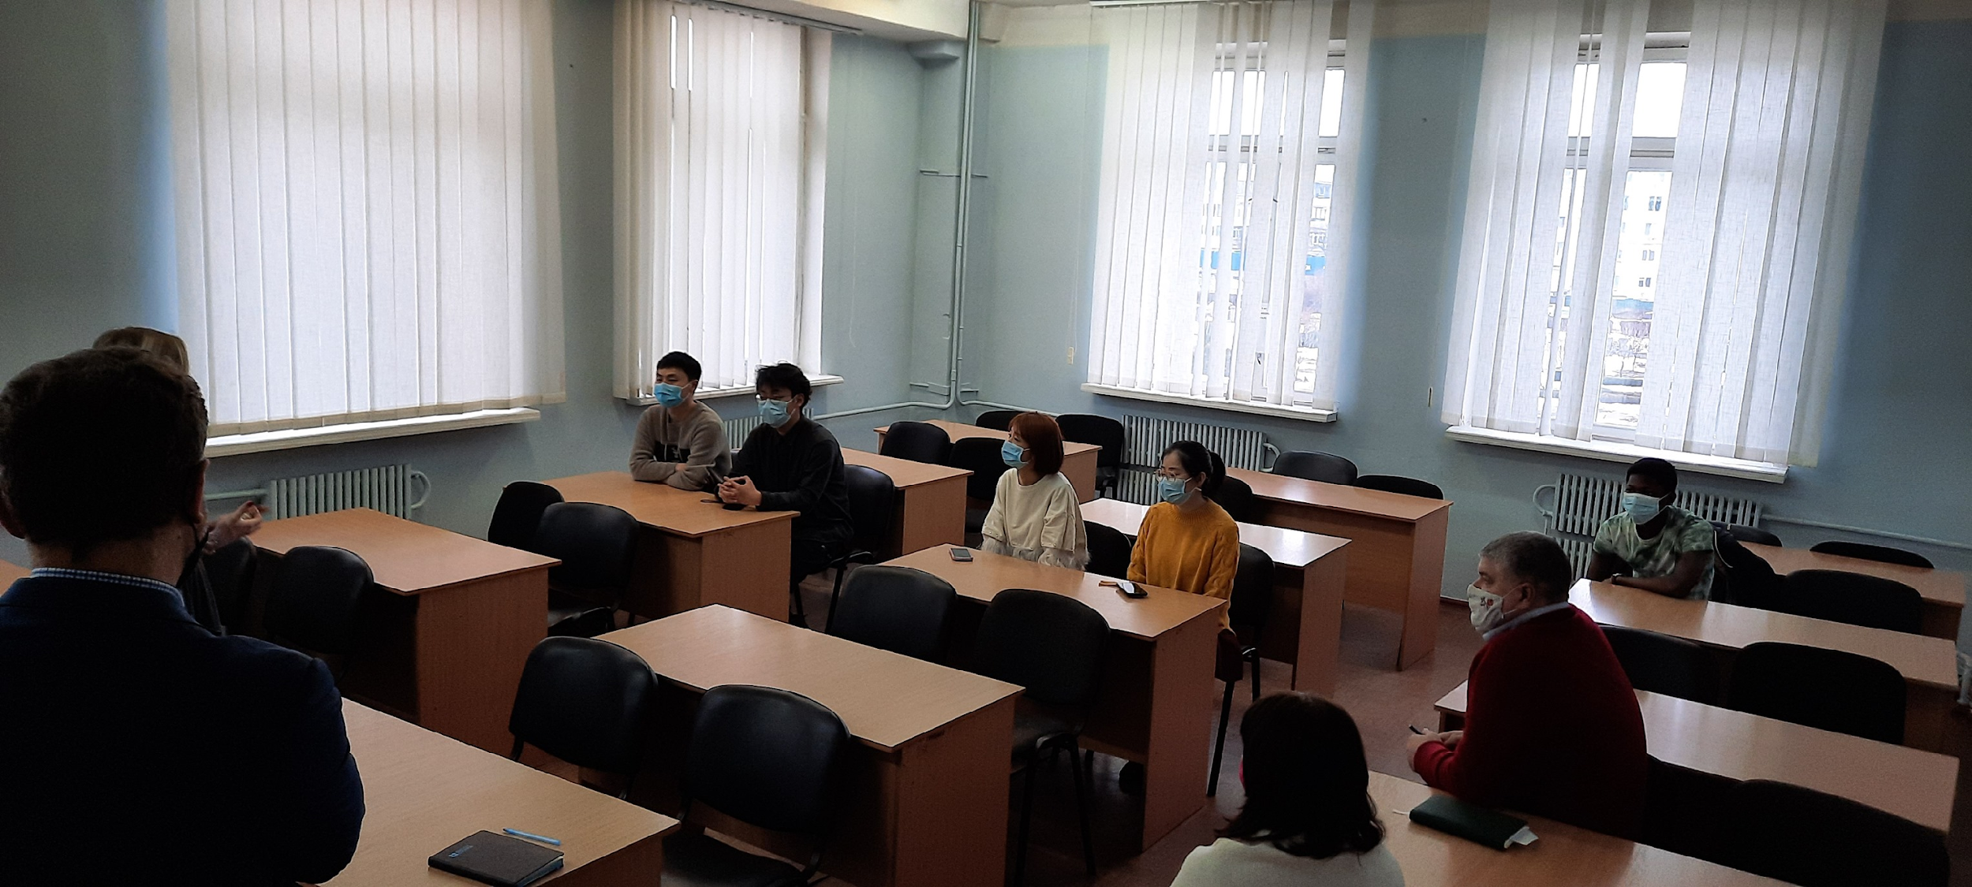
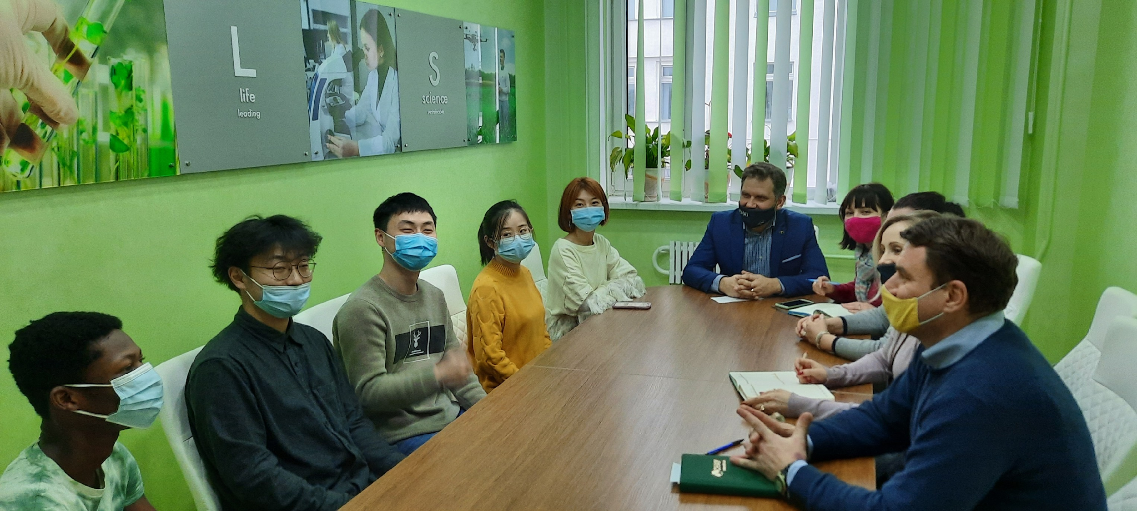
ISs INVOLVEMENT INTO THE PROJECT GOVERNANCE
https://bit.ly/3hDq3Mc
https://bit.ly/39h5P64

Slide 25


PREVENTIVE MONITORING of the project:
619451-EPP-1-2020-1-NL-EPPKA2-CBHE-JP
INTERNATIONAL STUDENTS
ADAPTATION AND INTEGRATION /
INTERADIS
SUMY NATIONAL AGRARIAN UNIVERSITY
Kharkiv, V. N. Karazin Kharkiv National University
01.10.2021
THANK YOU FOR ATTENTION

